Slide 1
Aspinwall Borough, Blawnox Borough, O’Hara Township, and Sharpsburg Borough
Fire Regionalization Study
September 6, 2023
Chuck Miller, DCED/GCLGS Fire Peer Consultant

Slide 2
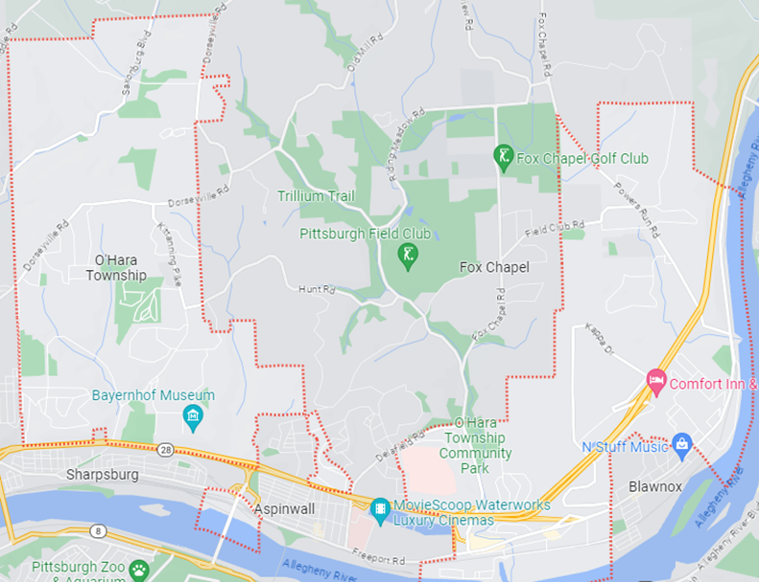
The REGION

Slide 3
Region overview
8.84 square miles
16,845 residents
4 Fire Department (7 stations)
19 pieces of fire apparatus
Budget:
Aspinwall $89,388
Blawnox $54,000
O’Hara $472,303
Sharpsburg $136,645

Slide 4
Regionalized fire service
4 Fire Stations
13 Pieces of Fire Apparatus
Initial Combined Budget $752,336
Reduced cost in operation
Avoid unnecessary duplication of equipment and resources
Increased purchasing power
Centralized management and administration

Slide 5
Who is in charge
5 Member Board of Commissioners
Elected official from each community
Can be expanded if other communities want to become part of the regional department
Fulltime Fire Chief
Oversee the day to day operations of the department and reports directly to the Board of Commissioners

Slide 6
Stations
Close the current Aspinwall Fire Stations and build a new station located at vacant property located centrally to both Aspinwall and Sharpsburg.
Close an O’Hara Township Station
Build an O’Hara Township Station in the Northeastern area of O’Hara Township
Close Sharpsburg Fire Department and consolidate equipment with Aspinwall in a newly built centralized station.
Keep Blawnox Fire Station at current location. Explore options to consolidate both Blawnox stations into one.

Slide 7
equipment
Front Line
(4) Engines
(2) Aerials
(1) Heavy Rescue
(4) Squads
(1) Chief’s Unit
(1) Reserve Engine

Slide 8
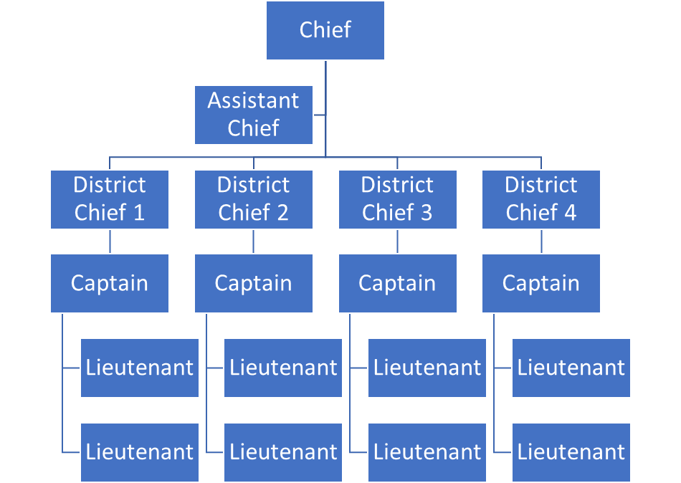
Command & control

Slide 9
Funding
Fire Tax
Fire Code Enforcement Fees
Donations
Board of Commissioners will need to determine best option for cost sharing

Slide 10
Questions

